Slide 1
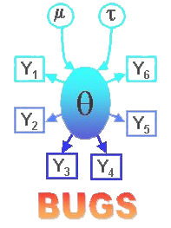
Running WinBUGS on your Mac
Emily Lewis, Elena Hubbard, Kelsey Sharp, Megan Robison, Hilary Lynch, Alex McIntre, Kyle Johannsen, and Lucy Tucker

Slide 2
Ways To Access
Best Way:
    VLab: easily accessed, free, and easy to utilize
Other Ways:
    JUGS: different Bugs program that can run on Mac and Windows- We could not get them to work properly on the Mac so good luck!
    Bootcamp and Virtualization Methods: Dual booting your computer will slow its processing down, also purchasing Windows is just a waste of money and for any of these solutions is a must buy.

Slide 3
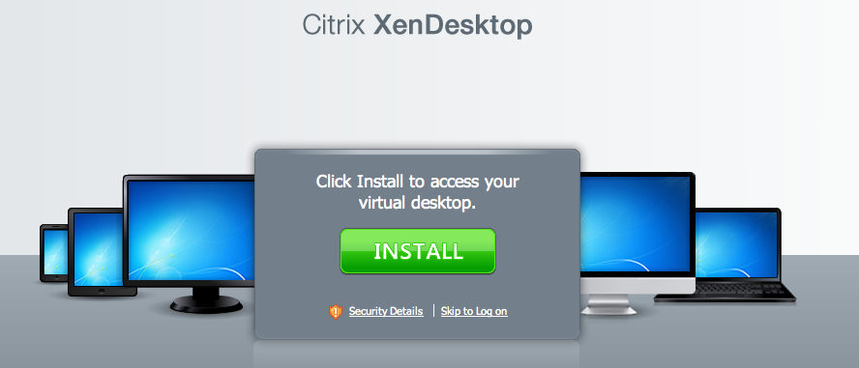
Getting Started with VLab
    Step 1: Enter the following URL in your browser vlab.matrix.gatech.edu
    Step 2: Click the green install button and download the “Citrix Plug-in”
    Step 3: Open the .dmg file you downloaded and click the “Install Citrix Online Plug-in” icon to install it (follow the installer’s prompts)

Slide 4
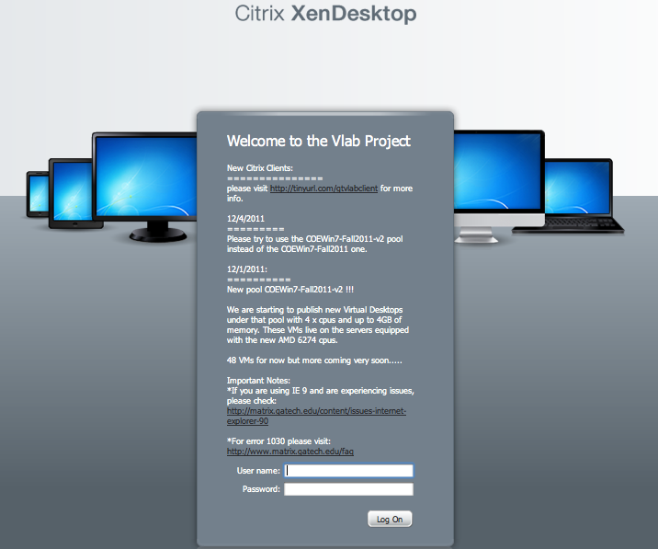
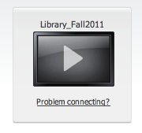
Once you've installed, accessing VLab
    Step 4: Click the continue button on the Citrix website
    Step 5: Login using your Georgia Tech username and password
    Step 6: Click on Library_Fall2011

Slide 5
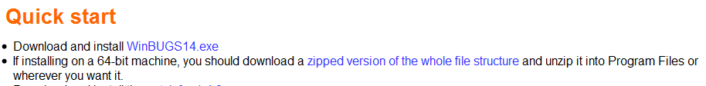
Accessing WinBugs Download
    Step 7: Go to the WinBUGS website a
    http://www.mrc-bsu.cam.ac.uk/bugs/winbugs/contents.shtml
    Step 8: Click on “zipped version of the whole file structure”
    Step 9: Once the download is complete, extract the zip file and save it to your desktop

Slide 6
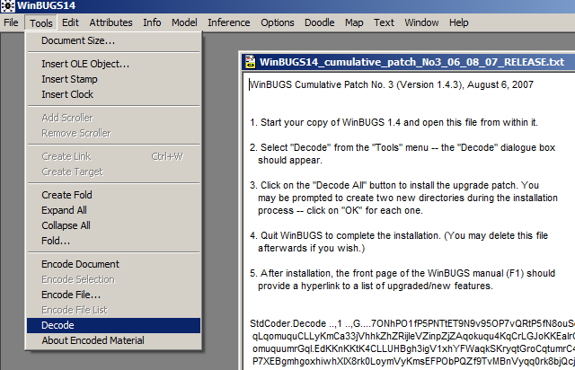
Installing WinBugs
    Step 10: Install the patch (1.4.3) from http://www.mrc-bsu.cam.ac.uk/bugs/winbugs/contents.shtml
    (follow the instructions after clicking the link)
    Step 11: Install the key from: http://www.mrc-bsu.cam.ac.uk/bugs/winbugs/WinBUGS14_immortality_key.txt
    (again follow the instructions after clicking the link)

Slide 7
Mounting WinBUGS on your prism account
    Step 12: Mount your PRISM drive by following the instructions at http://faq.oit.gatech.edu/node/84
    Step 13: Drag the WinBUGS14 folder into your PRISM drive

Slide 8
Questions? email: winbugs.macgroup@gmail.com

